Slide 1
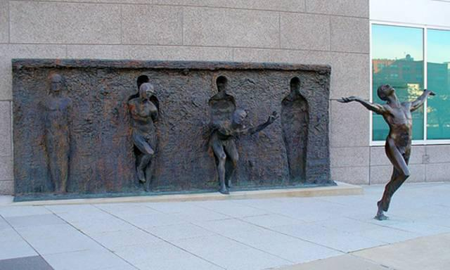
Personal Development & Team Leadership
Prof: Andrew PRIOR
Class 2: Morning-7Oct-2024

Slide 2
Course structure
About six weeks
About four weeks
Part 2:
My Team Leadership
capabilities:
About four weeks
Part 1:
Why leadership matters
understanding yourself now
Part 3: Creating and Communicating a Shared Vision
Understanding how you interact with individuals and groups
Using your new knowledge of yourself and team, to inspire others with a vision

Slide 3
Intention today
Comments from last weeks learning logs
Quiz on the Daniel Goleman video
More about EQ, understanding your results
Continuing exploring the Iceberg Model: about personality
Discovering the MBTI personality model
Things to do for next week
Learning Log
References & glossary

Slide 4
Comments from Learning Logs
The emotional intelligence is more important than IQ for "performance". E.Q. is a good asset for leadership. Listening without interrupting is a hard habit to loose but being in front of someone only listening is pleasant. Leadership is not management and is more focused on people than performance.
Leadership is important in a fast changing world. This can be connected to the concept of VUCA. It is important for maintaining and keep things under control (vertical construct), but also to move forward with a creative process (horizontal construct).
I learned a lot about each other's background and it was very interesting but also really fast so I wanted to know more about them because I found common points with them. And also I learned something about myself that I don't really tell to people usually.
Maybe using a microphone would positively affect the learning environment
The beginning of the class was a bit sleepy and too calm for a Monday morning. The fact of making students move, form groups, draw and write on a sheet keep our intention up !

Slide 5
Questions from Learning Logs
Is it a good choice to choose someone as a manager if the person have no technical knowledge over a field (people working in the field that the person will manage)? Even if the person is a good manager.
How far can you go in telling random things about your life?
How to be more comfortable to give my opinions?
The example if someone wants to get out of the tribe to join another, isn't it to hard to kill him for that in Ireland?
Can our individual leadership style be hindered by our anxiety or stress? If a person tends to be anxious and lack self-confidence, does that limit their ability to be in leadership roles or are there solutions for them to be able to lead anyway?
Is it always possible to control our emotions? Aren’t certain people using their emotional intelligence to manipulate others?
What would the midterms be like?
How to manage a company without taking things to seriously/lightly to avoid hurting my capital health?
What I need to develop in myself to be a successful leader.
What was your biggest point of cultural adaptation when moving from UK/Scotland to France? How can we adapt to and manage a new cultural situation?
If there is a student who is willing to learn about Chinese culture Chinese I will help him
Is diversity really a strength? Isn't it better to connect on the basis of similarity between people?
How can I change the beliefs that are holding me back.

Slide 6
Material about self awareness:
‘Emotional Intelligence – why it can matter more than IQ’ by Daniel Goleman (Amazon) (Video link here)
‘Feel the Fear and Do it Anyway’, by Susan Jeffers (Amazon) (Full audio book) (Video book review)
Links on measuring EI (Bar-On test) (Online test) (General) (Hayes Group)
Coaching for Performance 5th edition by Sir John Whitmore https://www.performanceconsultants.com/coaching-for-performance-book
Psychosynthesis Leadership Coaching: A Psychology of Being for a Time of Crisis. By Aubyn Howard https://www.psychosynthesiscoaching.co.uk/the-book/
Fertile Void: Gestalt Coaching at Work by John leary-Joyce https://www.gestalt.uk/fertile-void
“Immunity to change” by Robert Kegan and Lisa Laskow Lahey (Amazon) (Summary 14 mins)

Slide 7
Tasks from last week for this class:
Think deeply about your commitment to the work of the class.
Complete the EQ questionnaire (previous slide) – bring results to class next week
Watch the Goleman video (class quiz)
Think about what you want from the course. In week 14, by what criteria will you consider the course to have been a success?

Slide 8
Moodle Quick Quiz on the Goleman video

Slide 9
And, the answers to the quiz:
In the video, Daniel GOLEMAN said that Emotional Intelligence is:
About how we handle ourselves and our relationships
What are the four domains of Emotional Intelligence that Goleman talked about in the video?
b) Self-awareness, Self-management, Empathy, Putting it all together in skilled relationships
What is Goleman’s attitude to teaching kids about emotional intelligence?
c) Pro-social behavior and results will go up and it needs to be taught regularly

Slide 10
The part of the brain that supports emotional and social intelligence is:
The prefrontal lobe
The earliest part of the brain to become anatomically mature
The right side of the brain
The left side of the brain (10 points)
Which of the four domains did Goleman say that women are generally better at?
____ Empathy (10 points) (except in the top 10% of leaders where there is no difference between genders) (bonus 10 points)
Which of the four domains did Goleman say that men are generally better at?
____ Self-management (particularly handling stressful situations in groups) (10 points) (except in the top 10% of leaders where there is no difference between genders) (bonus 10 points)
The part of the brain that supports emotional and social intelligence is:
The prefrontal lobe
Which of the four domains did Goleman say that women are generally better at?
Empathy (except in the top 10% of leaders where there is no difference between genders)
Which of the four domains did Goleman say that men are generally better at?
Self-management (except in the top 10% of leaders where there is no difference between genders)

Slide 11
7. What did Goleman say about emotional intelligence in different countries? (From 04:46): “Emotional intelligence is a universal but it looks different in different places. Japan has a very rigid set of rules of social interactions, lots of subtleties.
Americans typically blunder into the Japanese system and don’t get what is going on. And, you know, it is embarrassing but they wouldn’t recognize emotional intelligence in a Japanese setting.
Brazil is a very different culture; it’s very outgoing, you know kind of like an Italian culture. And so, it (emotional intelligence) will look different from there but I think the fundamentals are the same.”

Slide 12
Back to the Emotional Intelligence discussion

Slide 13
Reminder:
Emotional Intelligence Defined
“The capacity for recognizing our own feelings and those of others, for motivating ourselves, for managing emotions well in ourselves and in our relationships.”
Source: Daniel Goleman
‘Emotional Intelligence’
Notes:
How do you feel at this present moment?

Slide 14
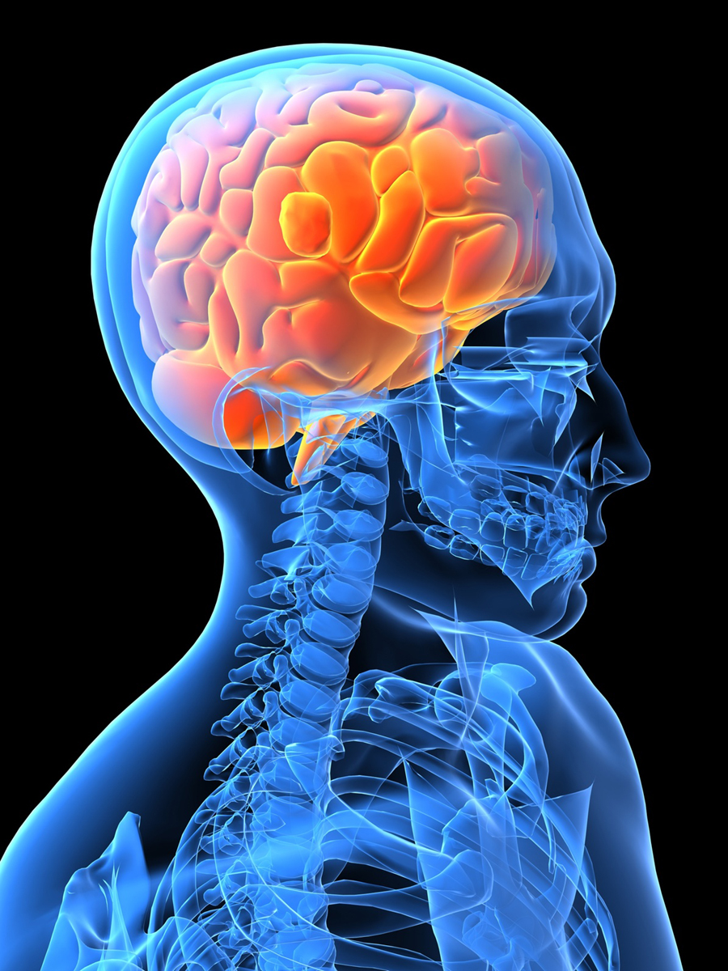
“Emotional Intelligence can be learned.
The process is not easy. It takes time and commitment.”
Daniel Goleman
Emotional Intelligence
14

Slide 15

Emotional Intelligence begins with understanding yourself
Self
Others
Self-
Awareness
Social
Awareness
Awareness
Source: Daniel Goleman
Actions
Self-
Management
Relationship Management
Positive impact on others
Notes:
Understanding, personality, culture, beliefs, norms and bad habits!
- May have been told that you must never express your feelings or motivations!
Self management –
What action do you take to motivate yourself?
What do you do to make sense of your life? To give it purpose?
What is your (change) agenda? What do you want to achieve? Which bad habits to turn into effective ones. Which action to challenge beliefs, change yourself
Research made on personal change. Read the book “Immunity to change”
14 frogs on a wall. 3 decided to jump. How many remaining on the wall? Difference between deciding and actually doing it. Between intention and action.
Dr told people that high risk of heart failure – need to take medications, change diet etc
6 out of 7 didn’t change…..so they died prematurely. Only 1 changed
Didn’t take action!

Slide 16
Research supports this:
Self-Awareness is at the heart of the model:
ECI research found that if people lack Self-Awareness, their chances of having Self-Management and Social Awareness are much reduced
Low
Self-
Awareness
17% chance
Social
Awareness
4% chance
Self-
Management
Source: Daniel Goleman

Slide 17
The Competency Framework
Self-
Awareness
Social
Awareness
Emotional Self-Awareness
Accurate Self-Assessment
Self-Confidence
Empathy
Organizational Awareness
Service Orientation
Source: Daniel
Goleman
Self-
Management
Relationship Management
Emotional Self-Control
Transparency
Adaptability
Achievement Orientation
Initiative
Optimism
Developing Others
Inspirational Leadership
Change Catalyst
Influence
Conflict Management
Teamwork & Collaboration

Slide 18
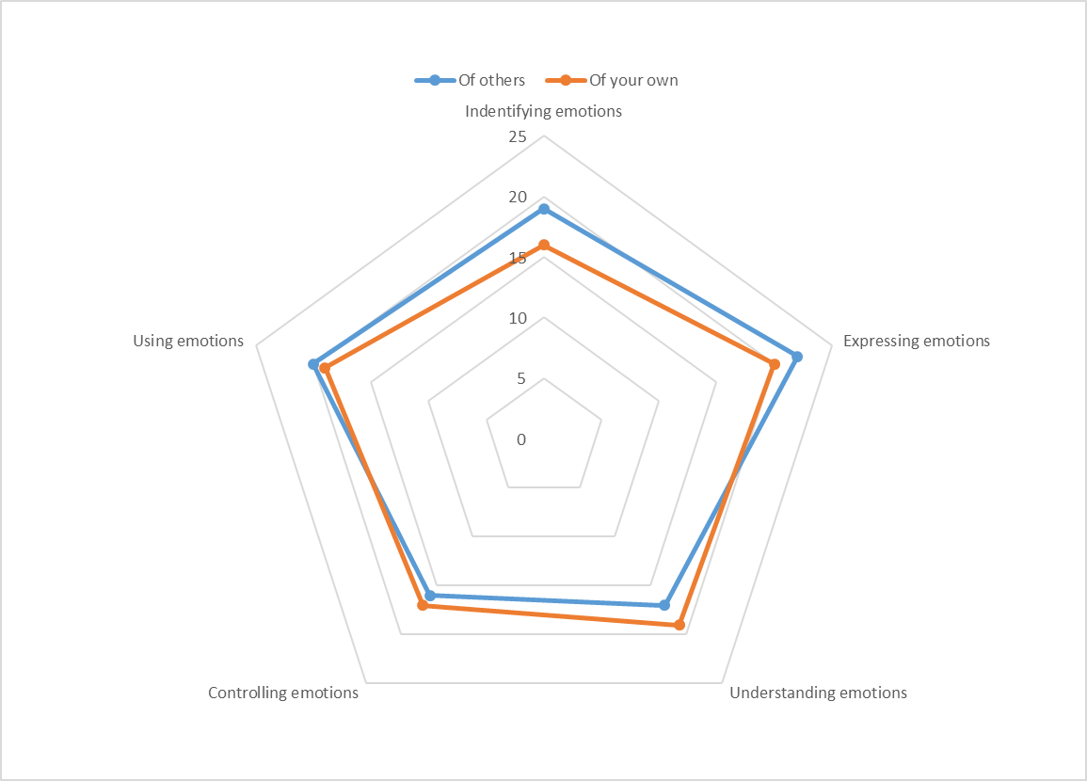
Reading the EQ questionnaire results
Download link is here!
Others
Self

Slide 19
Activity: Share your EQ questionnaire results in your learning group. What learning objective do you have for the course with respect to your EQ? 2 mins each 5 mins in group

Slide 20
Why do we behave the way we do?
Learn to be mindful of how you are seen by others, and why
The ‘iceberg’ model:
Behavior
Let’s explore this in more dept now
Observable
The hidden attributes drive behavior
Culture learned attitudes & beliefs
Personality mainly innate/genetic
‘Hidden’
Human nature – innate/genetic
20

Slide 21
Awareness: Mapping Uncertainty Avoidance with Power-distance
Created by K. Pope from Hofstede/Bond results

Slide 22
Awareness: Mapping Power distance with Individualism/Collectivism
Example: Tough to implement SMWT’s*:
Highly individualistic
But, tends to want others to take responsibility
Created by K. Pope from Hofstede/Bond results
See https://www.hofstede-insights.com/country-comparison-tool?countries=
* SMWT’s: self-managed work teams

Slide 23
Culture shock: The confusion, disorientation and emotional upheaval of moving to a different ‘country’
This is what generally happens on an intensive graduate
program too!
High
Mood
Phase I
- Novelty
Phase II
Disillusion
-ment
Phase III
- Frustration
Phase IV
- Learns to cope
Low
1 2 3 4 5 6
Months in ‘foreign’ culture
Kübler-Ross, E. (1969). On Death and Dying (The original framework for the Five Stages of Grief).

Slide 24
Remember that the ‘cultures’ of the ‘tribes’/groups to which we belong influence our behavior
The good news about learned culture(s) is that we can un-learn it, or re-learn it, if we really want to!
‘Nationality’
School
Family
Beliefs
Profession
Some examples
Peer-group
Company

Slide 25

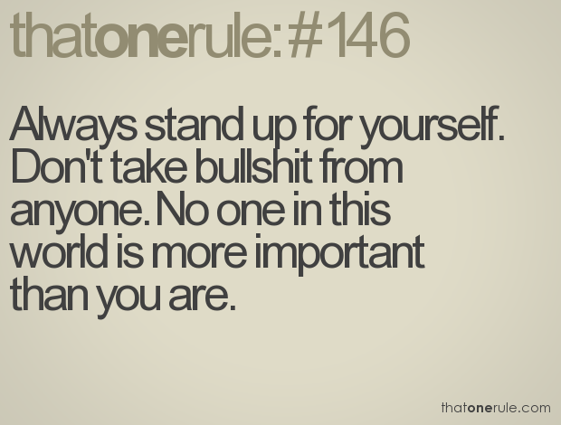
Understanding self: beliefs & assumptions
Galileo was judged to be a heretic for suggesting that the Earth moved around the Sun which was against mainstream beliefs at the time (1632)
Who was right? Perspective?
Other examples related to tribal beliefs?:
USA most powerful nation on earth?
China is the centre of the world?
Others?
Have the courage to stand up to what you believe and have the humility to remember that a belief is always based on assumptions (that may not be correct)

Slide 26
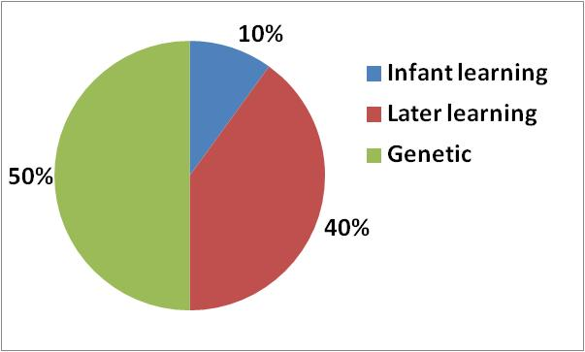
How much choice do we have?
(Rough approximations)

Slide 27
Behaving professionally: So, what can I do to respond better?
Understand yourself:
The national cultural influences that helped ‘form’ you
How those impact your ‘usual’ behavior
Your personality (more on this later) – unique to you but cultural overtones impact behavior
In addition, understand others:
Neither of you is ‘right’, the world needs all cultures (civilization)
Learn to observe how they/you behave in certain situations
Learn to observe yourself in your interactions:
‘Helicopter view’
What just happened, and why?
I’m doing it again!
If I had behaved differently, would I have been more successful?
These will help you to become more ‘mindful’
= more effective
= better liked
= live a fuller life
= be more successful
= happier and less stressed

Slide 28
Activity exploring culture
Pair with someone that you do not know well, from a different country
Person A, introduces themselves. Tells their nationality
Person B says what their impression of that nationality is. Person A does not respond
Reverse roles
Discuss whether the first impressions of each national culture were true
Discuss what is common in the two cultures
Discuss what happened, what did you learn, be ready to share your conclusions

Slide 29
A perspective on behavior
Learn to be mindful of how you are seen by others, and why
The ‘iceberg’ model:
Observable
Behavior
The hidden attributes drive behavior
Culture –learned attitudes & beliefs
Personality - mainly innate/genetic
‘Hidden’
Human nature – innate/genetic
29

Slide 30
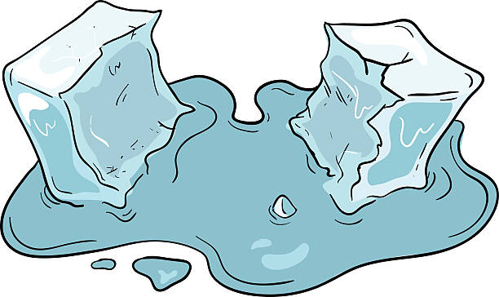
A short icebreaker

Slide 31


30
10
1
28
47
2
21
39
19
29
12
20
38
48
46
3
11
37
13
23
31
41
15
6
14
24
22
32
4
5
42
49
33
51
40
50
25
17
45
34
35
27
52
44
9
16
36
43
53
26
18
7
8
54
www.opp.com/icebreakers From: Thomas Lorenz, Angelika Hӧcker “Wert-voll leben”, Gabal Verlag, Offenbach 2014 | www.a-m-t.de
Notes:
You can either stop this exercise when the first person to finish identifies themselves, or allow everyone to finish. It’s worth putting everyone at ease at this point by recognising the exercise was actually quite difficult. All the numbers look slightly different; different shapes, different sizes.
So what has this got to do with people and personality?
Link to next slide
Although the numbers appear randomly placed, there *is* an underlying system, logic, framework to their clustering.

Slide 32
1
2
3
10
11
12
4
5
6
7
8
9
www.opp.com/icebreakers From: Thomas Lorenz, Angelika Hӧcker “Wert-voll leben”, Gabal Verlag, Offenbach 2014 | www.a-m-t.de
Notes:
Count through the numbers pointing out the pattern. Explain that by applying a framework you can see the pattern more clearly.

Slide 33
30
10
1
28
47
2
21
39
19
29
12
20
38
48
46
3
11
37
13
23
31
41
15
6
14
24
22
32
4
5
42
49
33
51
40
50
25
17
45
34
35
27
52
44
9
16
36
43
53
26
18
7
8
54
www.opp.com/icebreakers From: Thomas Lorenz, Angelika Hӧcker “Wert-voll leben”, Gabal Verlag, Offenbach 2014 | www.a-m-t.de
Notes:
Explain that once the underlying framework is understood, the exercise becomes much easier to complete.
Link to next slide
Tell your group to try the exercise again but this time with the understanding of the framework.

Slide 34
30
10
1
28
47
2
21
39
19
29
12
20
38
48
46
3
11
37
13
23
31
41
15
6
14
24
22
32
4
5
42
49
33
51
40
50
25
17
45
34
35
27
52
44
9
16
36
43
53
26
18
7
8
54
www.opp.com/icebreakers From: Thomas Lorenz, Angelika Hӧcker “Wert-voll leben”, Gabal Verlag, Offenbach 2014 | www.a-m-t.de
Notes:
Allow people to try the exercise again and they will find that it is much easier.

Slide 35

Why this icebreaker?
There may be those who do not like the idea of ‘being put into a box’
The exercise shows that some system of organization of knowledge helps us to understand complexity

Slide 36
The idea of preferences

Slide 37

An experiment on preferences
Take a piece of paper, and sign your name

Slide 38
MBTI Personality Self-Assessment
This link goes to the official Myers-Briggs® Foundation website to find ‘More about type’, books and articles on the subject
MBTI: Myers Briggs Type Indicator – a personality assessment approach (more here)
Also a link here MBTI® Facts, answering your questions about the Myers-Briggs Type Indicator®

Slide 39
MBTI: the preferences:
Attitudes
Mental processes
What gives you energy?
How do you collect information?
How do you take decisions?
How do deal with the world?

Slide 40
Start with E-I Attitudes
Extraversion
Energised by outer world
Judgement
Prefer a planned, decided, orderly way of life
Introversion
Energised by inner world
Perception
Prefer a flexible, spontaneous way of life
Source of energy
S
N
Information gathering
T
F
Decision making
External Life style

Slide 41
Source of Energy
Extraversion Introversion
Feels pulled outward by external claims and conditions
Feels pushed inward by external claims and instructions
Energized by other people, external experiences
?!?!
Energized by inner resources, internal experiences
Acts, then (maybe) reflects
Reflects, then (maybe) acts
…and I said you´ll never believe what I saw… let me tell you….
..well alright ..
Is often friendly, talkative, easy to know
Is often reserved, quiet, hard to know

Slide 42
Source of Energy
Extraversion Introversion
Expresses emotions
Bottles up emotions
Needs relationships
Needs privacy
Gives breadth to life
Gives depth to life
I´s may seem withdrawn to E´s
E´s may seem shallow to I´s
https://www.youtube.com/watch?v=4tT3rAo2s4s
https://www.youtube.com/watch?v=fsEPMB5Usck

Slide 43
Activity for Extraversion - Introversion
Each person has a card with a number from 1 to 5
Form groups with a sum total of 12 or 9 (or as near as possible) – 5 mins
Do it NOW!!
Describe observations of different strategies that were being played out:
Shouting to all
Showing / Looking at cards
Approaching one-on-one
Settling down with exact number or near as possible

Slide 44
Which one is your gift?
E I
Extraversion
Active
Outward
Sociable
People
Many
Expressive
Breadth
Introversion
Reflective
Inward
Reserved
Privacy
Few
Quiet
Depth
https://www.wimp.com/the-power-of-quiet

Slide 45
Verifying Your Type Preferences
Very Clear Clear Moderate Slight
Slight Moderate Clear Very Clear
Extraversion
Energised by outer world
Sensing
Work with known facts
Thinking
Base decisions on impersonal analysis and logic
Judgement
Prefer a planned, decided, orderly way of life
Source of energy
Introversion
Energised by inner world
INtuition
Look for possibilities & relationships
Feeling
Base decisions on personal values
Perception
Prefer a flexible, spontaneous way of life
Information gathering
Decision making
External Life style
E/I S/N T/F J/P
1. ”Self-Assessment” Type _______ _______ _______ _______
2. ”Indicator” Type _______ _______ _______ _______
3. ”Best Fit” Type _______ _______ _______ ______

Slide 46
Key Mental Processes & Functions
Sensing
Works with known facts
Thinking
Bases decisions on impersonal analysis and logic
INtuition
Looks for possibilities & relationships
Feeling
Bases decisions
on personal values
Gathering of Information
Taking Decisions

Slide 47
Gathering of Information
Sensing iNtuition
Looks at patterns and relationships
Looks at specific parts and pieces
A
B
Y X
Lives in the present,
enjoying what´s there
Lives toward the future
anticipating what might be
Prefers handling practical matters
Prefers imagining possibilities, models and theories
Likes things that are definite, measurable
Likes opportunities for
being inventive

Slide 48
Gathering of Information
Sensing iNtuition
Starts at the beginning, takes a step at a time
Jumps in anywhere, leaps over steps
5
3
4
2
3
5
2
1
1
4
1. Alfjllajfla
2. Alödjfapod
3. Aölsdkfjpp
4. Lajflkjaöldf
5…..
Works hands-on with parts
to see the overall design
Studies the overall design to see how the parts fit together
Likes set procedures, established routines
Likes change and variety
N´s may seem fickle, impractical
dreamers to S´s
S´s may seem materialistic and literal-minded to N´s

Slide 49
Activity for Sensing - iNtuition
Do it NOW!!
Choose:
Go to the left side if you think you are “Sensing”
Go to the right if you are more like “iNtuition”
Remember both are equally important (we are only trying to find our preference)
Make small subgroups of about ~3-5 people:
Create a flip chart / A3 or white board – gather information about going from Eurecom to Nice airport (5’)
Present information to a person who’s going there and has never done that journey before (2’)

Slide 50
Which one is your gift?
S N
Sensing
Details
Present
Practical
Facts
Sequential
Directions
Repetition
Enjoyment
Perspiration
Conserve
iNtuition
Patterns
Future
Imaginative
Innovations
Random
Hunches
Variety
Anticipation
Inspiration
Change
https://www.youtube.com/watch?v=V52NSf1ccOg

Slide 51
Key Mental Processes and functions
Sensing
Works with known facts
Thinking
Bases decisions on impersonal analysis and logic
INtuition
Looks for possibilities & relationships
Feeling
Bases decisions
on personal values
Gathering of Information
Taking Decisions

Slide 52
Taking Decisions
Thinking Feeling
Decides with the head
Decides with the heart
The logical thing to do is...
What I feel is...
Goes by logic
Goes by personal convictions
Concerned for
relationships, harmony
Concerned for truth, justice
Sees things as onlooker from outside a situation
Sees things as a participant, from within a situation

Slide 53
Taking Decisions
Thinking Feeling
Spontaneously finds flaws, criticizes
Spontaneously appreciates
Good at analyzing plans
Good at understanding people
Takes a long view
Takes an immediate and personal view
T´s may seem cold and condescending to F´s
?
?
?
F´s may seem fuzzy- minded and emotional to T´s

Slide 54
Activity for Thinking - Feeling
Choose your position
Front half of classroom if you have a Thinking preference
Back half if you have a Feeling preference
Again in groups discuss the following situation
A fun soccer competition (“mixed”) with MIT and other top Eng. schools in Hawaii. Improve networking and co-operation between organizations. At the moment only enough budget to send 11 players. Your are the Eurecom association committee deciding on what to do. Discuss & be ready to explain how you made your decision (5’)
Present decision on an A3, flip or white board (2’)

Slide 55
Which one is your gift?
T F
Thinking
Head
Objective
Justice
Cool
Impersonal
Criticise
Analyse
Precise
Principles
Feeling
Heart
Subjective
Harmony
Caring
Personal
Appreciate
Empathize
Persuasive
Values
https://www.youtube.com/watch?v=-4EDhdAHrOg

Slide 56
Attitudes
Extraversion
Energised by outer world
Judgement
Prefer a planned, decided, orderly way of life
Introversion
Energised by inner world
Perception
Prefer a flexible, spontaneous way of life
Source of energy
S
N
Information gathering
T
F
Decision making
External Life style

Slide 57
External lifestyles
Judging Perceptive
Prefers an organized lifestyle
Prefers a flexible lifestyle
Likes definite order &structure
Likes going with the flow
Prefers to experience life as it happens
Likes to have life under control
Enjoys being decisive
Enjoys being curious, discovering surprises
STOP!!

Slide 58
External lifestyles
Judging Perceptive
1. Lsdakjflafj
2. Aölkdfjlka
3. Aöldkflakf
4. Aökdlkajdf
5. Aölkdf
Likes clear limits and categories
Likes freedom to explore
without limits
Feels comfortable maintaining openness
Feels comfortable establishing closure
Handles deadlines, plans in advance
Meets deadlines by last minute rush
1 2 3 4 5 6 7
8 9 10 11 12 13 14
15 16 17 18 19 20 21
22 23 24 25 26 27 28
29 30 31
J´s may seem demanding, rigid, uptight to P´s
P´s may seem disorganized, messy irresponsible to J´s

Slide 59
Activity for Judging - Perceiving
Where do you stand on this continuum?:
I have to finish my ------------------------- I can play anytime
work, before I play
What do you do on holiday?:
Know what you’re -------------------------- Will find out when
going to do we get there

Slide 60
Which one is your gift?
J P
Judging
Organized
Structure
Control
Decisive
Deliberate
Closure
Plan
Deadlines
Productive
Perceiving
Flexible
Flow
Experience
Curious
Spontaneous
Openness
Wait
Discoveries
Receptive
https://www.youtube.com/watch?v=9TnCgcNQl5Q

Slide 61
Verifying Your Type Preferences
Very Clear Clear Moderate Slight
Slight Moderate Clear Very Clear
Extraversion
Energised by outer world
Sensing
Works with known facts
Thinking
Bases decisions on impersonal analysis and logic
Judgement
Prefer a planned, decided, orderly way of life
Introversion
Energised by inner world iNtuition
Looks for possibilities and relationships
Feeling
Bases decisions on personal values
Perception
Prefers a flexible, spontaneous way of life
Source of energy
Information gathering
Decision making
External Life style
E/I S/N T/F J/P
1. ”Self-Assessment” Type ___E__ ___N___ ____F__ ___P__
2. ”Indicator” Type __E/I__ ___N___ ___T/F__ __J/P__
3. ”Best Fit” Type ____I__ ___N___ ___F___ ___P__

Slide 62
Verifying Your Type Preferences
Very Clear Clear Moderate Slight
Slight Moderate Clear Very Clear
Extraversion
Energised by outer world
Sensing
Works with known facts
Thinking
Bases decisions on impersonal analysis and logic
Judgement
Prefer a planned, decided, orderly way of life
Introversion
Energised by inner world iNtuition
Looks for possibilities and relationships
Feeling
Bases decisions on personal values
Perception
Prefers a flexible, spontaneous way of life
Source of energy
Information gathering
Decision making
External Life style
E/I S/N T/F J/P
1. ”Self-Assessment” Type ______ ______ ______ _____
2. ”Indicator” Type ______ ______ ______ _____
3. ”Best Fit” Type ______ ______ ______ _____

Slide 63
Assignment for class 3: Explore MBTI questionnaires and types. Find best fit for you
Online MBTI assessments: There are may online, for example: https://www.16personalities.com
Use them at your own risk. Check out privacy / data policies and what information you give them.
Official MBTI is tested and researched. Find a certified MBTI practitioner (I am certified)
Learn more about your type – see online links about MBTI
https://www.myersbriggs.org/my-mbti-personality-type/myers-briggs-overview/
https://www.themyersbriggs.com/en-US/Resources/MBTI-Shareables

Slide 64
Learning Log

